Slide 1
Instagram Analysis
-Intended for a General Audience-
Corey Austen
Notes:
My name is Corey Austen, and I will be presenting on an analysis I did on my wife’s Instagram. This is intended for a general audience.
*change slide*

Slide 2
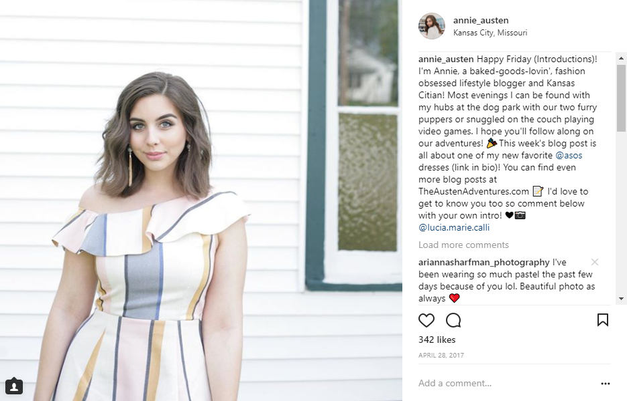
This is Annie
Annie has an Instagram
annie_austen
She also has a blog
theaustenadventures.com
Notes:
This is my wife, Annie. She has a highly curated Instagram, as well as a fashion blog. She has a very curated and maintained Instagram, as well as a blog.

Slide 3
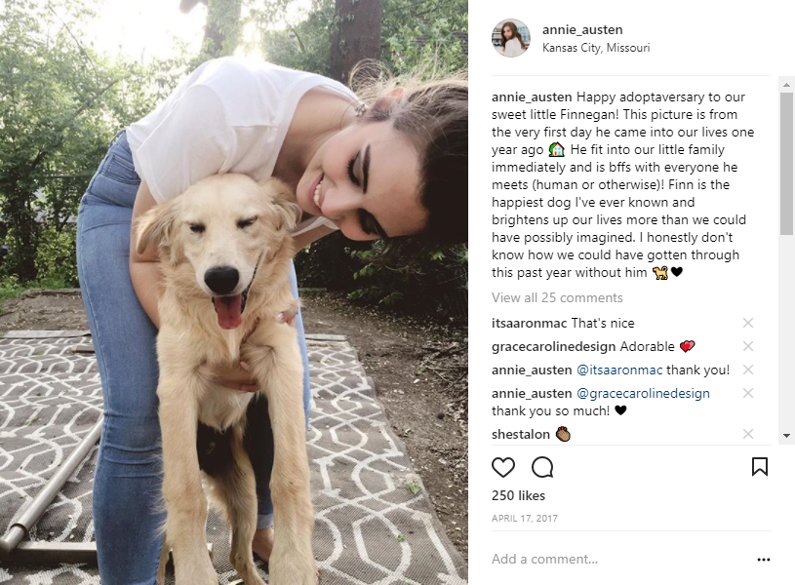
Questions
“What does she post about?!”
“Can I predict if a post will be a ‘great post?’”
Notes:
So, the overall point of my presentation is I want to use her Instagram to answer the question:
What does she post about!?! Its not that I don’t know, I’m a good and supportive husband. But if I can have software verify that, why not?
Also, can I predict whether something will be, in her eyes, a “great post.”

Slide 4
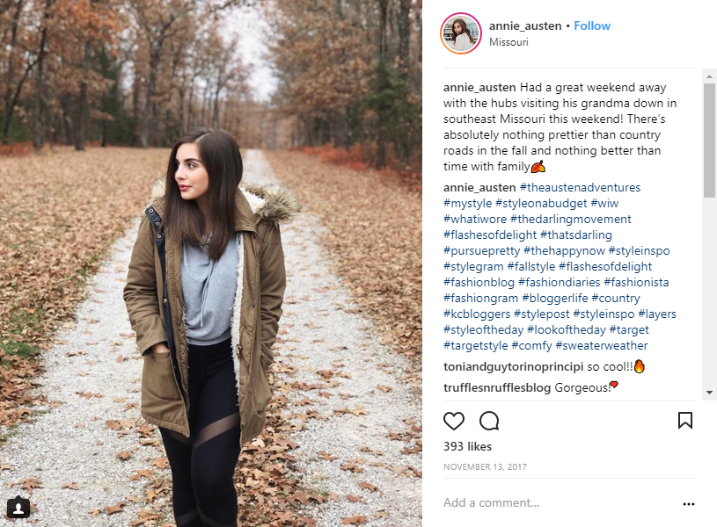

Annie’s Instagram
255 Instagram Posts
A “Great Post” = 250 Likes or more
41 Great Posts
Struggle of collecting the data
Hashtags
255 Instagram Posts
A “Great Post” = 250 Likes or more
41 “Great Posts”
Struggle of collecting the data
Emojis
Hashtags
Notes:
In total, at least when I pulled the data, there were 255 Instagram Posts.
When I asked her what she considers to be a really good post in terms of the number of “likes,” she said that any post that gets at least 250 likes is a great post.
So based on that, she had a total of 41 post that I labelled as “great.”
So when I started doing this, I admittedly didn’t know a whole lot about Instagram other than what she had told me in passing. Getting the information from Instagram was a bit more challenging than I had originally expected. There isn’t a clean way to just pull all of the text from your account, so I had to go to each post and copy/paste all the text out into Excel, along with writing down the likes. I also had to remove emojis from all the posts to
One challenge here was to figure out how to handle the Hashtags. The Hashtags are used to manually categorize the posts. However, she pointed out that many of those hashtags are “generic,” in that she adds them to literally every one to help increase visibility. Luckily she has a tool where she can apply a hashtag “template”, so I went ahead and removed them as they wouldn’t be much help with what I was trying to do.

Slide 5
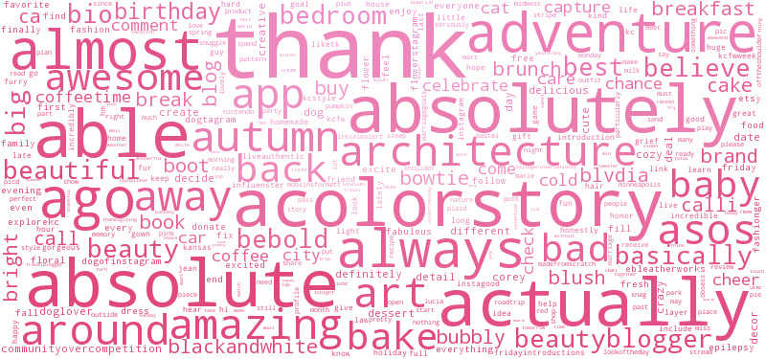
Word Cloud!
Notes:
Obligatory word cloud… notice anything weird? She REALLY likes “A” words. My wife, Annie Austen, is a big fan of alliterations.

Slide 6
What she posts about
Topic | Number of Posts | Number of “Great Posts” | Percentage of Topic = GP
Everyday Life | 69 | 6 | 8.6%
Blog/Fashion | 47 | 15 | 31.9%
Shopping | 42 | 11 | 26.1%
Kansas City | 37 | 6 | 16.2%
Food | 31 | 1 | 3.2%
Video Games | 12 | 1 | 8.3%
Breakfast | 11 | 1 | 9%
Autumn | 6 | 0 | 0%
Notes:
So here are all of her posts broken down into 8 categories:
Everyday life – Includes posts about our house, pets, travel, etc.
Posts about her blog – She does collaborations and goes to KC FashionWeek events, so those end up there
Shopping. *PRESS KEY*
My wife likes Target. So much so.. *change slide*

Slide 7
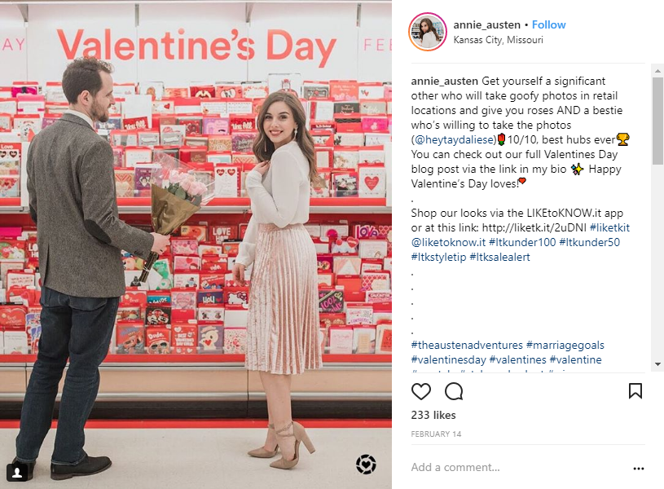
Did I mention that she likes Target?
Notes:
We did a photoshoot at Target for Valentines Day. She likes Target.

Slide 8
What she talks about
Topic | Number of Posts | Number of “Great Posts” | Percentage of Topic = GP
Everyday Life | 69 | 6 | 8.6%
Blog/Fashion | 47 | 15 | 31.9%
Shopping | 42 | 11 | 26.1%
Kansas City | 37 | 6 | 16.2%
Food | 31 | 1 | 3.2%
Video Games | 12 | 1 | 8.3%
Breakfast | 11 | 1 | 9%
Autumn | 6 | 0 | 0%
Notes:
Kansas City – Pictures around the city
Food – What is an Instagram account without pictures of food?
Video Games - we go charity livestreams and *CHANGE SLIDE*

Slide 9
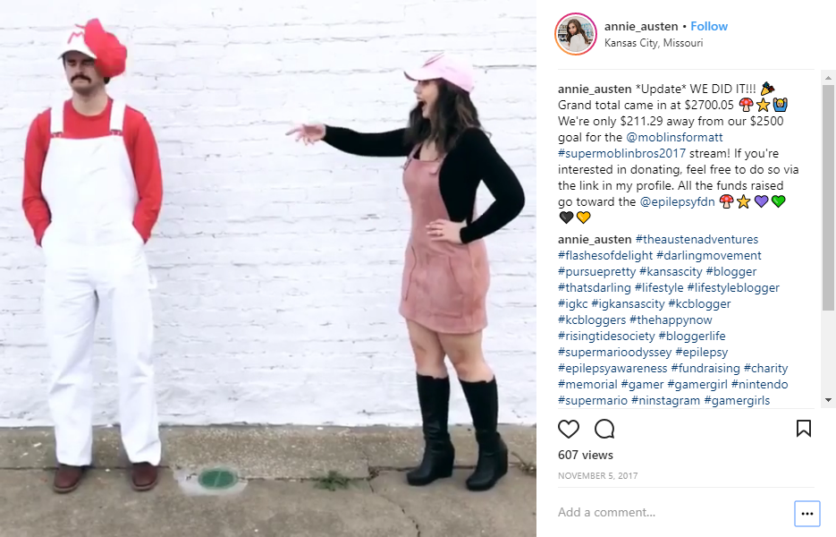
We are nerds…

Slide 10
What she talks about
Topic | Number of Posts | Number of “Great Posts” | Percentage of Topic = GP
Everyday Life | 69 | 6 | 8.6%
Blog/Fashion | 47 | 15 | 31.9%
Shopping | 42 | 11 | 26.1%
Kansas City | 37 | 6 | 16.2%
Food | 31 | 1 | 3.2%
Video Games | 12 | 1 | 8.3%
Breakfast | 11 | 1 | 9%
Autumn | 6 | 0 | 0%
Notes:
Another thing I noticed is that breakfast *PRESS KEY*
had its own topic (I asked her about that and she said “the lighting is the best in the morning...plus...*Ron Swanson Quote*.”

Slide 11
To quote Ron Swanson:
Notes:
There has never been a sadness that can’t be cured by breakfast food.

Slide 12
What she talks about
Topic | Number of Posts | Number of “Great Posts” | Percentage of Topic = GP
Everyday Life | 69 | 6 | 8.6%
Blog/Fashion | 47 | 15 | 31.9%
Shopping | 42 | 11 | 26.1%
Kansas City | 37 | 6 | 16.2%
Food | 31 | 1 | 3.2%
Video Games | 12 | 1 | 8.3%
Breakfast | 11 | 1 | 9%
Autumn | 6 | 0 | 0%
Notes:
Autumn (Thanksgiving, her favorite holiday)
Now using these topics, we can see was that posts in the “Blog/Fashion” topic *PRESS KEY* did extremely well, with 31.9% of them being labeled as “great posts.”
*PRESS KEY*
Shopping also didn’t do too bad with 26.1%.

Slide 13

Prediction (Decision Tree)
No Hashtags
All Hashtags
Removing Common Hashtags
Overall Accuracy rate of 79%
How often could it pick out the “great posts”?
No – 88%
Yes – 12%
Overall Accuracy rate of 73%
How often could it pick out the “great posts”?
No – 84%
Yes – 27%
Overall Accuracy rate of 85%
How often could it pick out the “great posts”?
No – 91%
Yes – 38%
Notes:
Overall, the model known as the decision tree was the most accurate in terms of predicting whether a post was a great post or not, and I decided to show its performance with the data structured 3 different ways:
1. Removing all hashtags, meaning only the actual text of the post is looked at.
2. Leaving in all hashtags, including the ones that are seen on every post
3. Removing the common hashtags, so only the unique ones are left in.
As we can see, removing the common hashtags gave us the best overall prediction outcome. *PRESS KEY*
Now, it should be noted that although the overall prediction rate is 85%, the rate at which it can pick out the great posts themselves is only 38% of the time, so I probably wouldn’t hand this model over to Annie and be confident that she would start getting more likes.

Slide 14
The Results
What she talks about:
Everyday Life
Blog/Fashion
Shopping
Kansas City
Food
Video Games
Breakfast
Autumn
Model with 85% accuracy in predicting “great posts,” but not necessarily useful.
Most successful topics:
Blog/Fashion
Shopping
Notes:
So, to recap:
The analysis brought about 8 different categories. I found that it was possible to predict her “great posts,” but not well enough to be useful. It may be possible to get better results in the future with some additional data, but I’ll have to wait until she posts more pictures. The information I did find that could be helpful to her in getting more likes on her posts is that her most successful topics are her blog and her shopping adventures.

Slide 15
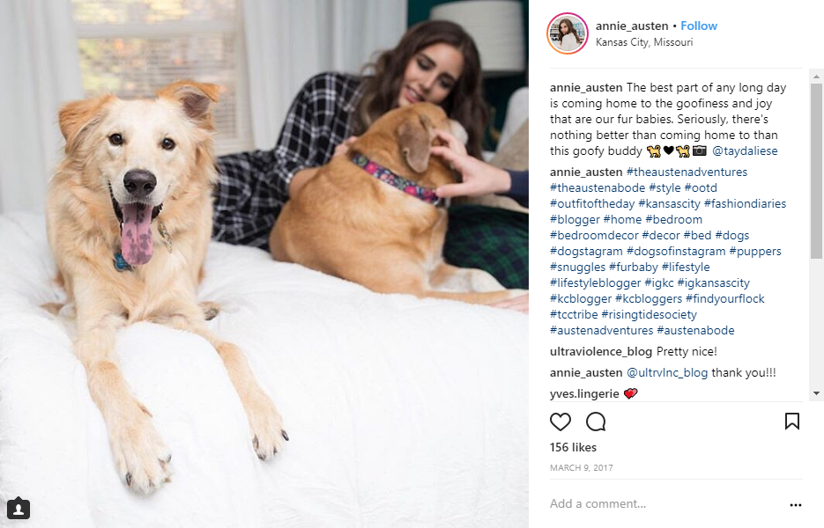
Questions?
Notes:
Any questions?
Thank you.

